Slide 1
CLASSIFICATION OF MACHINE FAILURE
Mentor : Munmun Bhagat

Slide 2
Team Members:
Eliyaz Manikyam
Melvin Thomas
Revathi C
Rutuja khakare
Santhosh Prabhu
Suhas Sawanth
Vishakha Achmare

Slide 3

Problem Statement:
In industries, re-evaluating their maintenance schedules is necessary for this digitalization era as smart as possible for production enhancements.
Predictive maintenance offers great opportunities to businesses for a smarter and more digital facility. Using this dataset our objective is to predict when the machine is more likely to fail.

Slide 4
Business Objective:
The objective of this project is to implement various Predictive Maintenance methods and assess the performance of the machine and predict failures before time with the given dataset.
To assess, we consider on the below methods:
Failure detection
Classification of types

Slide 5
Architecture Flow:
Data Exploration
Model Building
Model Evaluation
Deployment
Data Acquisition

Slide 6
Analysis Of The Given Dataset
Data Size
Machine Failure
Machine Failure Identification
Rows: 10000
Columns: 14
Parameters
Air Temperature
Process Temperature
Rotational Speed
Tool Wear
Torque
Machine Failure
TWF : Tool wear Failure
PWF : Power Failure
OSF : Overstrain Failure
HDF : Heat Dissipation Failure
RNF : Random Failure
Divided into a Binary Class
Where 1 = Failure
And 0 = No Failure
From the provided data it is possible to do a failure detection and a classification of types of failure

Slide 7
Exploratory Data Analysis
Analysis of the Dataset

Slide 8

Exploratory Data Analysis:
Checking Null and Duplicated Values:
No Null values
No Duplicates

Slide 9
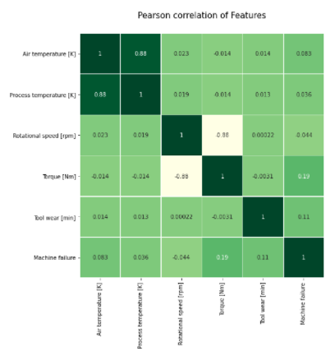
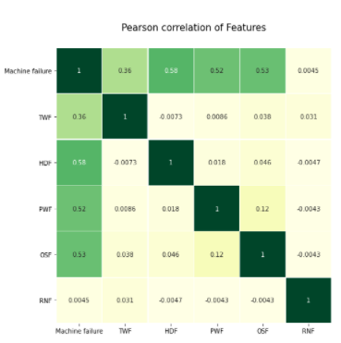
3. Co-relation Of The Features

Slide 10
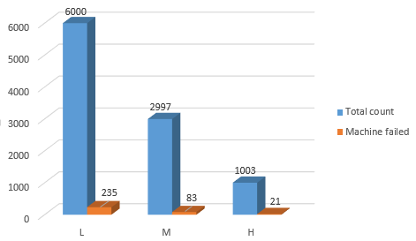
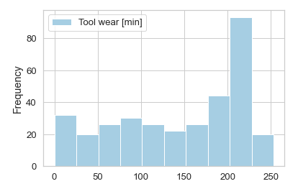
4. Comparing the distribution of failure over type of machine
Machine Failure in Types
Low product : 3.91%
Medium product : 2.76%
High product : 2.09%
5. Distribution of Machine failure over Tool wear.
Tool wear can be pre calculated with respect to time
Machine has failed over 80 times when it is in the range of 200-225 minutes.

Slide 11
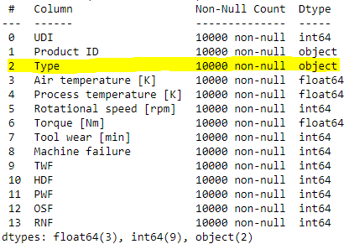
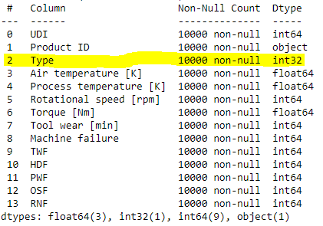
6. Feature Engineering
The Object Column Type was Label Encoded

Slide 12
6. Feature Engineering (contd):
Detection of Outliers
Isolation Forest
Treating outliers
Removing the outliers rows where Machine failure which is ‘0’
Balancing the dataset
Oversampling the dataset using SMOTE
2000 rows of outliers
Out of 2000, 220 has machine failure as ‘1’ and rest as ‘0’
Detection of outliers using Isolation forest:
Total 2000 rows had outliers.
Out of which 220 had machine failure as ‘1’.
Treating outliers where the machine failure was ‘0’ by under sampling.
Balancing the data: Oversampling using SMOTE.

Slide 13
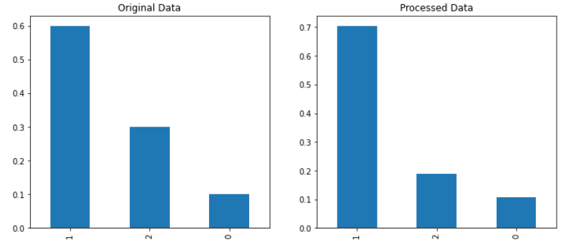
7. Checking the originality of processed data. A. Comparison on Distribution of Types
Type 1: Low
Type 2 : Medium
Type 3 : Highest
Class | Original Dataset | Processed Datatset
Type 1 | 60% | 70.5%
Type 2 | 30% | 19.0%
Type 3 | 10% | 10.5%

Slide 14
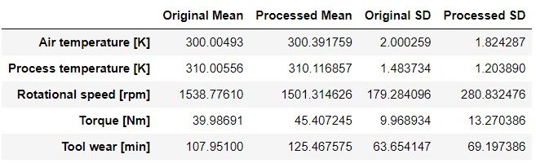
B. Comparison on Mean and Standard Deviation
Air and Process temperature hasn't changed much in both Original and Processed data.
Rpm, Torque and Tool Wear has changed a bit because of the treatment of outliers.

Slide 15
C. Comparison on Distribution of Failure Types
Type of Failures such as HDF, PWF, OSF, TWF hasn’t changed much.
Random Failure has changed much in the processed dataset
RNF doesn’t depend on the input parameters so the oversampling model was not able to duplicate it.

Slide 16
MODEL BUILDING
Analysis of classification Models

Slide 17
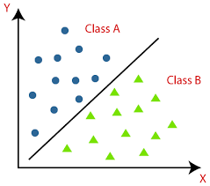
SPLITTING THE DATA
Train Data:- 80%
Test Data: - 20%
Classification models built:
Logistic Regression
Decision Tree
Random Forest
Naive Bayes
SVM
ANN- Neural Networks
XGBoost

Slide 18
MODEL EVALUATION
Comparison on built Models

Slide 19
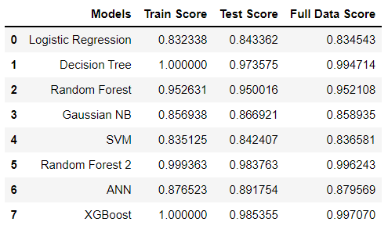
Models Evaluation: Accuracy Score
Comparing the Train, Test and Complete data Accuracy of the models we have decided to choose XGBoosting algorithm to be the efficient option for this particular problem.

Slide 20
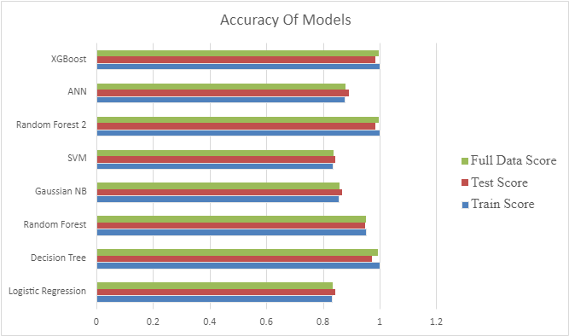
Model Comparision

Slide 21
MODEL DEPLOYMENT
Deploying the model in a user interface

Slide 22
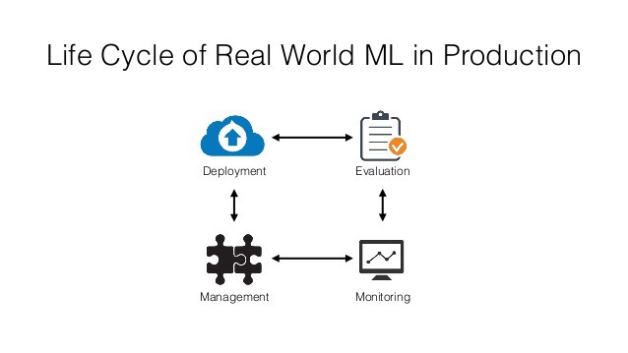
MODEL DEPLOYMENT
Model deployment is simply the engineering task of exposing an ML model to real use.
The term is often used quite synonymously with making a model available via real-time APIs.
It refers to the application of a model for prediction using a new data.
It is one of the last stages in the machine learning life cycle

Slide 23
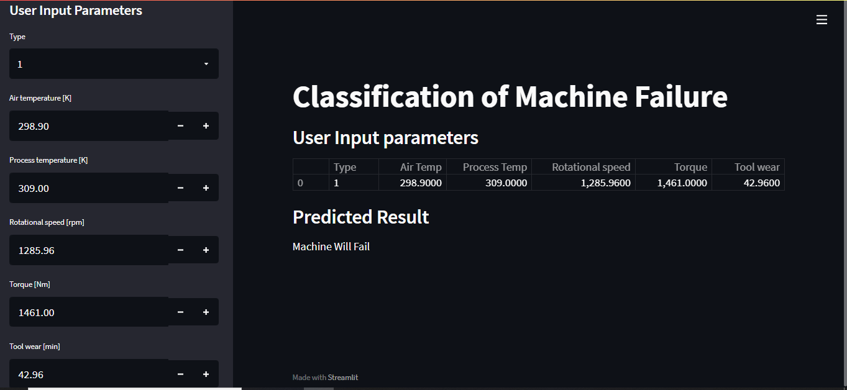
Deployment: User Interface
If we enter into these parameters we will get the result whether the Machine will FAIL or NOT

Slide 24

Deployment: Front End Webpage
GO TO THE WEBPAGE

Slide 25
Challenges Faced
Model Building:
Exploring and implementing with different models.
Correcting the errors from the dataset.
Increasing the accuracy score for the dataset.
Choosing the Final model and the evaluation metric.
Deployment :
Choosing the deployment platform.
Understanding the working of Streamlit.

Slide 26
Overcoming the Challenges
Referred few Github projects to get a idea on model building.
Removed outliers and tuned the dataset.
We choose Accuracy as our evaluation metric.
User-friendly and easy to deploy platform.
Gaining hands on practice on Streamlit.
Overcoming the errors that happened during Deployment

Slide 27


